Slide 1

IMAGE CLASSIFICATION PROJECT
SUBMITTED BY:
NAINCY JOSHI

Slide 2
IMPORTING THE DATASET
The image classification dataset been scrapped using selenium through E-commerce website.
The dataset has been uploaded on the google drive.
We have mounted the google colab with the google drive so that we can connect the dataset through the drive

Slide 3
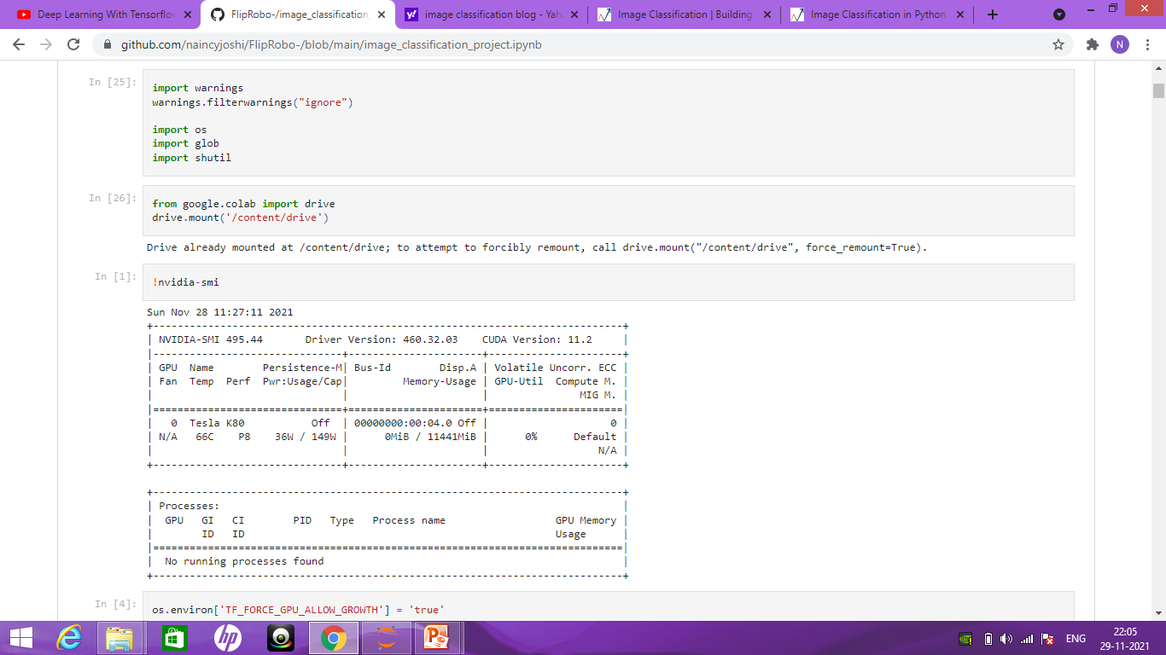

Slide 4
Importing the Libraries:
We have imported the important libraries and then stored the path of the train data and the test data.
The train data path has been stored with the attribute train_path and the test data been stored on the test_path
We will be using Inception V3 for image classification.

Slide 5
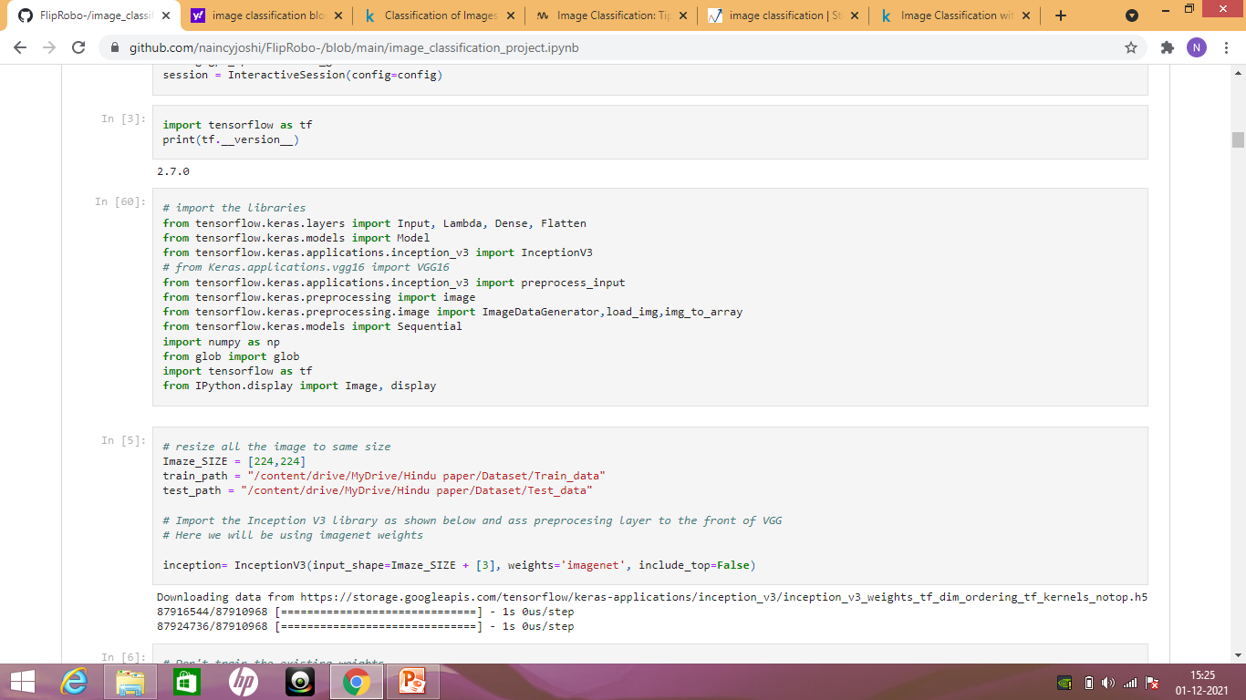

Slide 6
Inception V3
Factorization into Smaller Convolutions
2. Spatial Factorization into Asymmetric Convolutions
3. Utility of Auxiliary Classifiers
4. Efficient Grid Size Reduction
# The total loss used by the inception net during training. total_loss = real_loss + 0.3 * aux_loss_1 + 0.3 * aux_loss_2

Slide 7
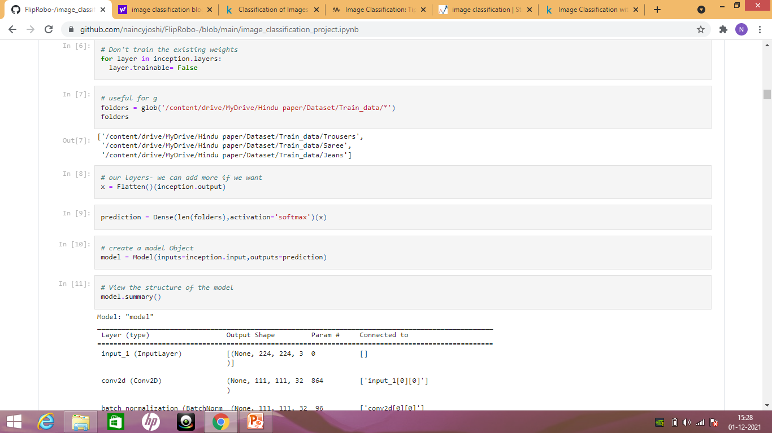

Slide 8
The first layer in this network, tf.keras.layers.Flatten, transforms the format of the images from a two-dimensional array (of 28 by 28 pixels) to a one-dimensional array (of 28 * 28 = 784 pixels). Think of this layer as unstacking rows of pixels in the image and lining them up. This layer has no parameters to learn; it only reformats the data.
After the pixels are flattened, the network consists of a sequence of two tf.keras.layers.Dense layers. These are densely connected, or fully connected, neural layers. The first Dense layer has 128 nodes (or neurons). The second (and last) layer returns a logits array with length of 10. Each node contains a score that indicates the current image belongs to one of the 10 classes.

Slide 9
Pre-Processing
Softmax extends this idea into a multi-class world. That is, Softmax assigns decimal probabilities to each class in a multi-class problem. Those decimal probabilities must add up to 1.0. This additional constraint helps training converge more quickly than it otherwise would.
Softmax might produce the following likelihoods of an image belonging to a particular class:
Model . Summary() will provide the details of the project shape and imaze size and many more

Slide 10
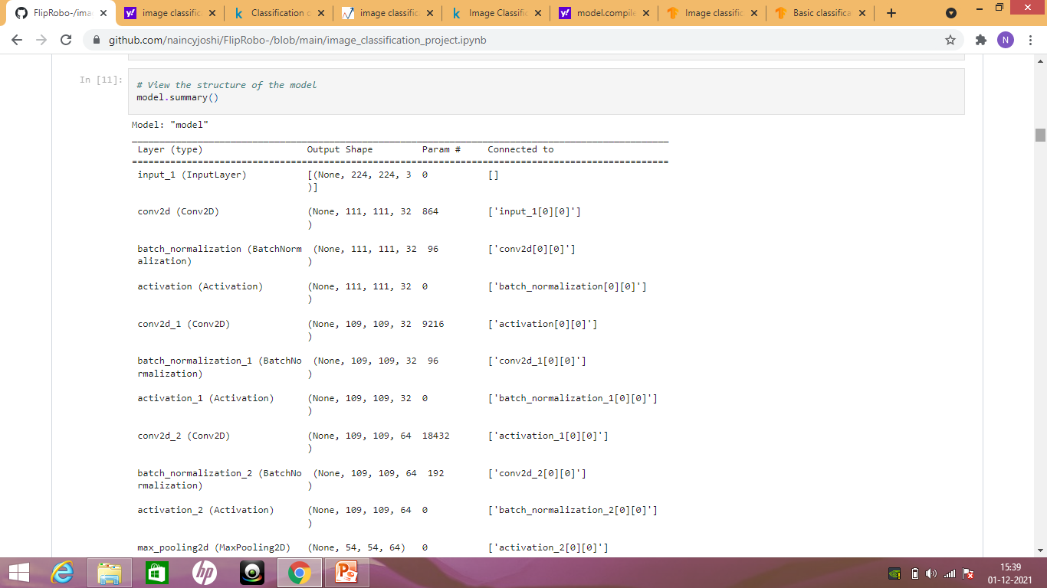
Model summary

Slide 11
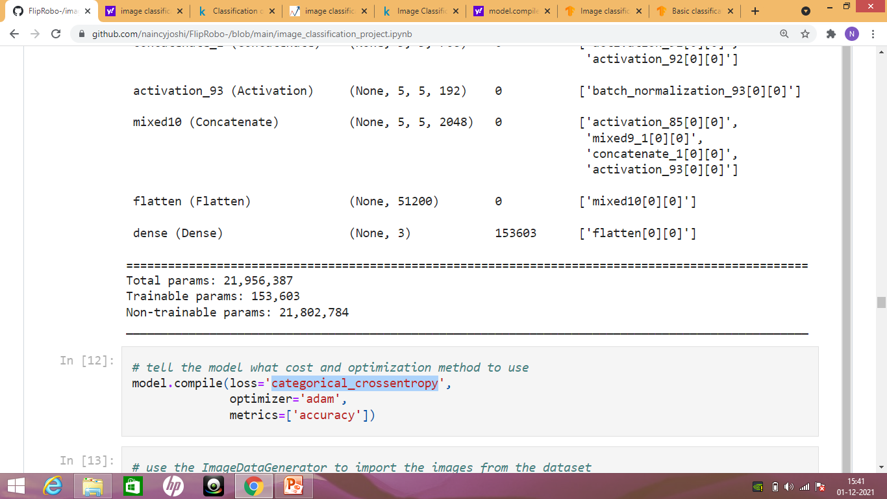
Model Compile

Slide 12
For this project, we have choose the tf.keras.optimizers.Adam optimizer and tf.keras.losses.CategoricalCrossentropy loss function. To view training and validation accuracy for each training epoch, pass the metrics argument to Model.compile.
Loss function —This measures how accurate the model is during training. You want to minimize this function to "steer" the model in the right direction.
Optimizer —This is how the model is updated based on the data it sees and its loss function.
Metrics —Used to monitor the training and testing steps. The following example uses accuracy, the fraction of the images that are correctly classified.

Slide 13
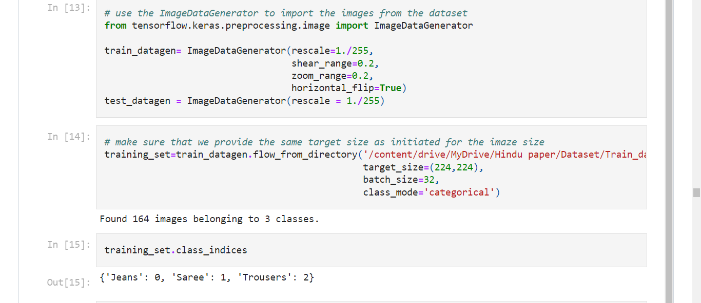
Image Data Generator

Slide 14
As we can see that there is three classes in the data set. The classes are Jeans , saree and the Trouser.
We have set the imaze size as 244*244.
We took shear imaze and the zoom imaze as 20%.

Slide 15
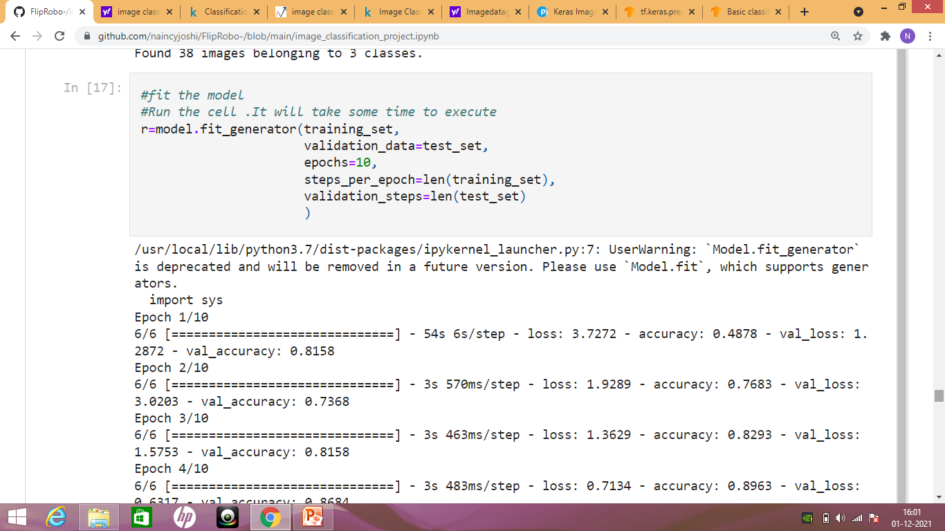
Fitting the model

Slide 16
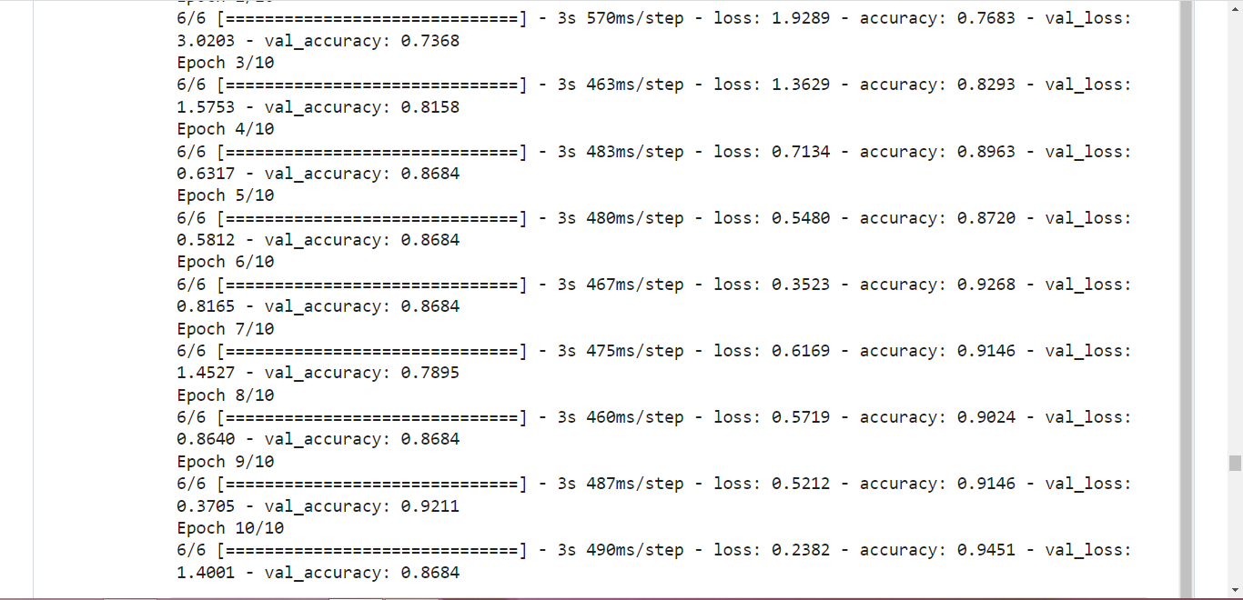

Slide 17
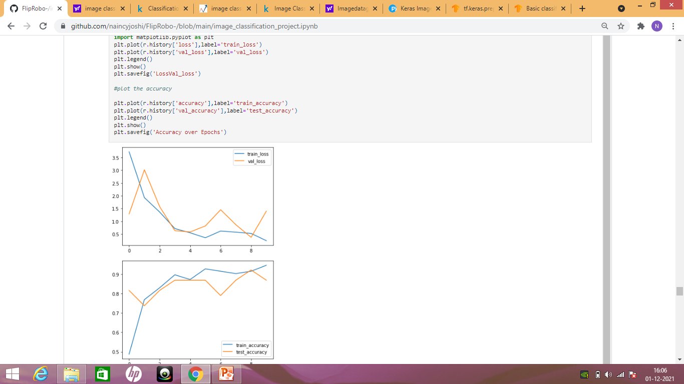
Train and Test Loss and Accuracy

Slide 18
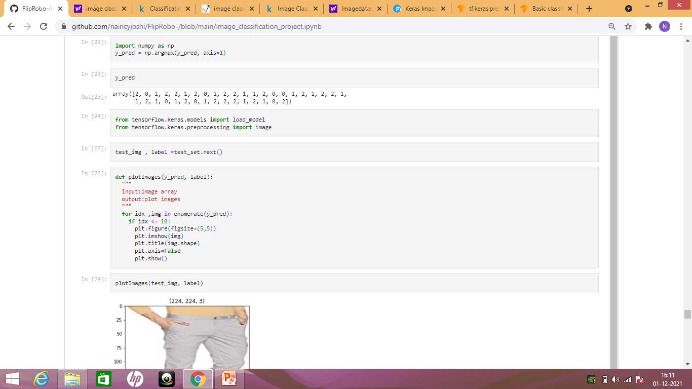
Predicted the model

Slide 19
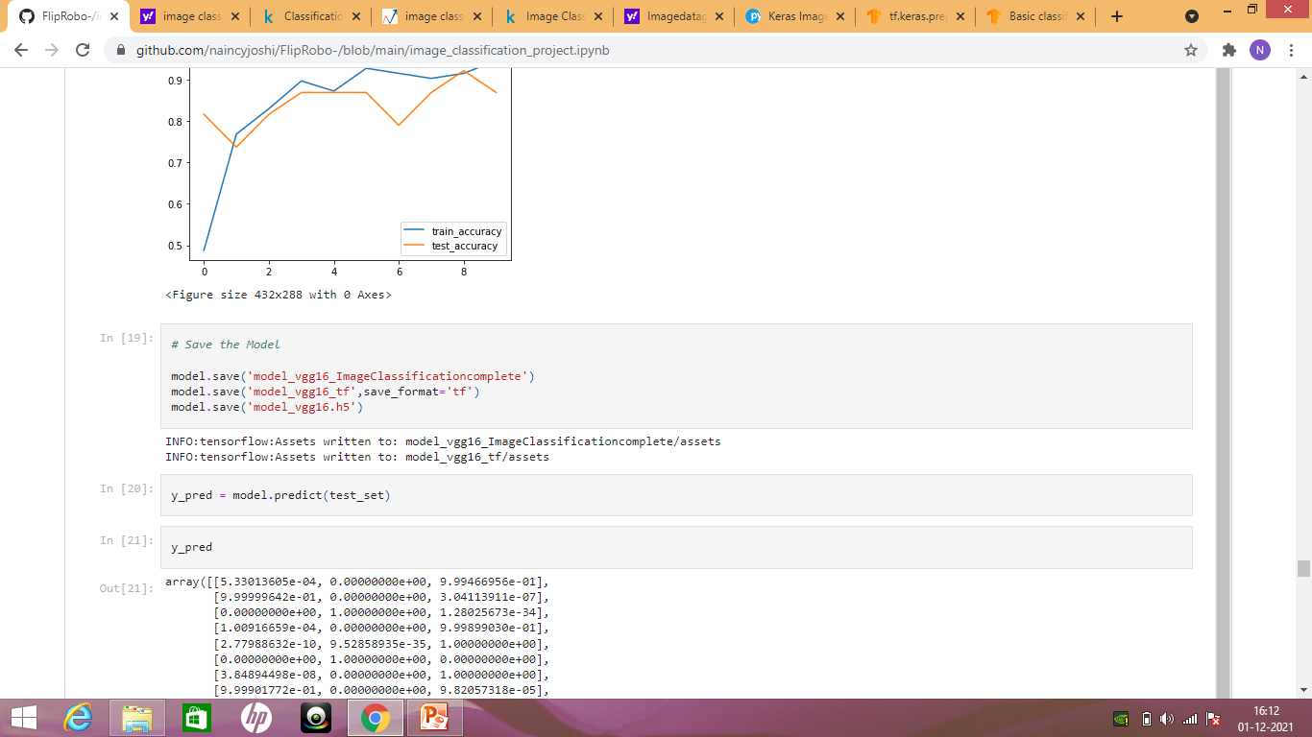
Saving the Model

